Slide 1
Digital Portfolio
STUDENT NAME: Thanga Raj
REGISTER NO AND NMID:24524U48033 AND 7C8628251774B4B981C4D50E854B2CD0
DEPARTMENT: B.Sc.,(Data Science)
COLLEGE: KARAN ARTS AND SCIENCE COLLEGE/ Thiruvalluvar University

Slide 2
Digital Portfolio
A responsive personal website built using HTML, CSS, and Javascript. Showcases skills, services, and achievements in a clean layout. Acts as a digital CV for recruiters and clients.

Slide 3


AGENDA
Problem Statement
Project Overview
End Users
Tools and Technologies
Portfolio design and Layout
Features and Functionality
Results and Screenshots
Conclusion
Github link
3/21/2024 Annual Review

Slide 4

PROBLEM STATEMENT
►Need for a personal website
►Showcase skills & services
►Easy way for recruiters/clients to know me

Slide 5

PROJECT OVERVIEW
► Responsive portfolio website
► Built using HTML, CSS, Bootstrap
► Sections : Home, About, Skills, Services, Work, Contact

Slide 6
Portfolio Sections Overview
Html explanation:
DOCTYPE & <html> → Declares it’s an HTML5 page.
<head> → Includes metadata, page title, and links to CSS/JS files. <header> → Shows name, course, and a toggle button for dark/light mode. <nav> → A navigation bar with links to sections (About, Skills, Projects, Contact). <main> → Main content with sections: About → Short introduction.
Skills → List of technical skills.
Projects → Descriptions of two sample projects.
Contact → A form to send messages.
<footer> → Copyright. <script> → Links to external JavaScript for interactivity.

Slide 7
explanation of CSS:
Base styles → Sets fonts, spacing, background, and smooth transitions.
Header → Green banner with name, description, and styled button.
Navigation bar → Dark bar with horizontal links that change color on hover.
Main content → Sections with spacing; headings in green.
Skills list → Flexible tags styled as pill-shaped badges.
Projects → White cards with hover effect (lift + shadow).
Form → Vertical layout, styled inputs, focus highlight in green.
Footer → Dark bar with centered white text.
Dark mode (.dark-mode) → Inverts background/text colors for night theme.
Responsive design → On small screens, nav links and skills stack vertically.

Slide 8
JavaScript:
toggleMode() → Switches between light and dark mode by adding/removing a CSS class.
Form handling → Runs when page is loaded.
On submit → Stops default form action, collects name, email, message.
Validation → Checks if all fields are filled.
Alert → Shows a thank-you message with the user’s input.
Reset → Clears the form after submission.

Slide 9

WHO ARE THE END USERS?
► Recruiters
► Clients
► Peers / Network
► Personal Branding

Slide 10

TOOLS AND TECHNIQUES
► HTML5
► CSS3
► JavaScript

Slide 11
POTFOLIO DESIGN AND LAYOUT
Navbar: Fixed, smooth scroll, mobile-friendly.
Hero: Intro text + profile image + CTA button.
About: Info on AI/ML + side image.
Skills: Grid cards with icons (ML, Python, etc.).
Projects: Responsive grid with project cards + buttons.
11

Slide 12
Contact: Info & social links (left), form (right).
Footer: About, Quick Links, Contact Info, social icons.
Responsive: Works on all devices, hamburger menu.
JS Features: Nav toggle, auto-close, validation, scroll effect.

Slide 13
🔹 Features
Modern UI with clean sections (Hero, About, Skills, Projects, Contact, Footer).
Responsive Design – adapts to desktop, tablet, and mobile.
Smooth Navigation with fixed navbar and scroll effects.
Interactive Sections – skills hover effects, project cards with buttons.
Contact Form – styled, with validation.
Social Media Integration – LinkedIn, GitHub, Twitter, Instagram.
🔹 Functionality
Navbar Toggle – hamburger menu opens/closes on mobile.
Auto-Close Navigation after clicking a link.
Form Validation & Reset – ensures proper input before submission.
Scroll Effect – navbar style changes when scrolling.
CTA Button – quick navigation to contact section.

Slide 14

RESULT AND SCREENSHORTS
Created a responsive portfolio website
Showcases skills, services, and achievements
Acts as a digital CV for career growth
3/21/2024 Annual Review
14

Slide 15
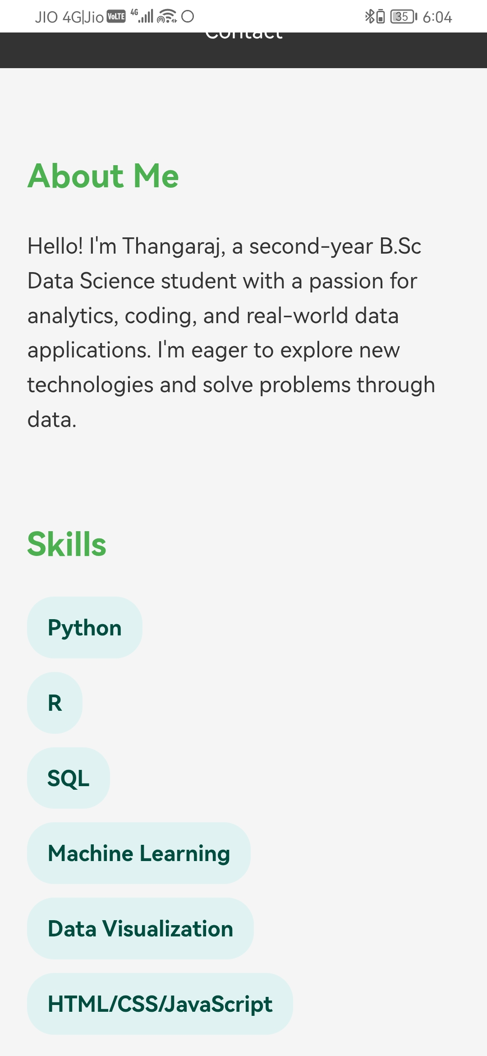
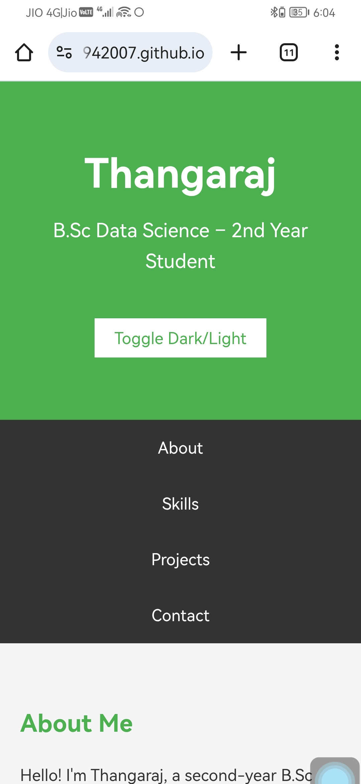

Slide 16
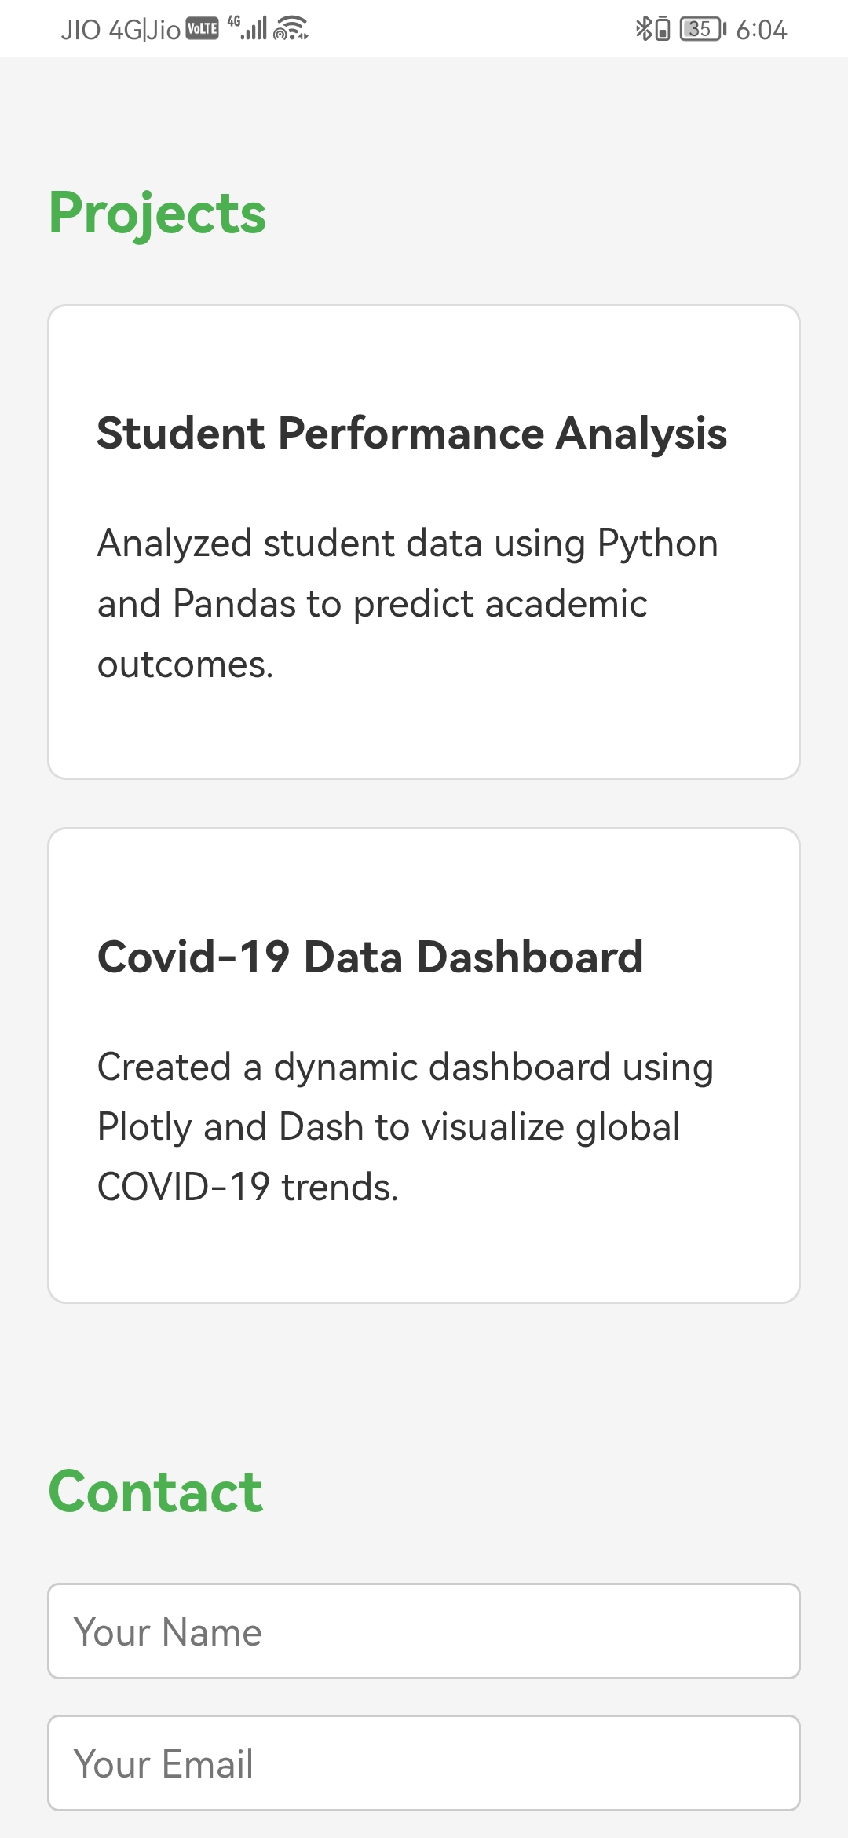
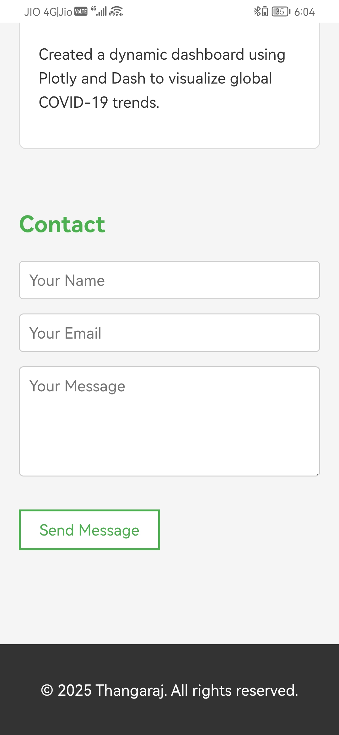

Slide 17
CONCLUSION
► Portfolio website built using HTML, CSS & JAVASCRIPT
► Showcases my skills, services, and achievements
► Helps in career growth and client reach
17

Slide 18
GITHUB LINK
https://github.com/thangaraj1942007

